Slide 1
What is Title Toolbox?
[brand image]
[contact info]
(You can insert contact info on the bottom of the last slide as well)

Slide 2
Title Toolbox is a cutting-edge property data system that provides Real Estate Agents with powerful data analytic tools never before seen by the industry.
Title Toolbox provides Real Estate Agents with these powerful tools and
meaningful analytics.
Now more than ever real estate professionals need the most up-to-date information
and expert insight to succeed in their markets.

Slide 3
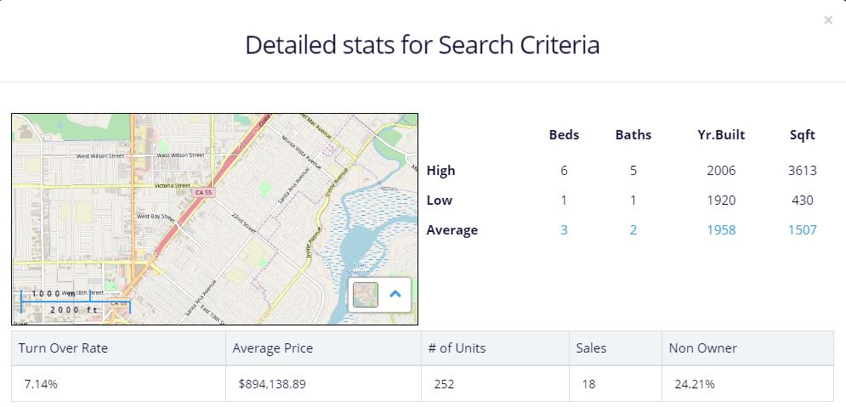
FARMING Know the turnover rate of your farms
Using Title Toolbox’s Farming module you can now see the turnover rate of any set of properties you choose.
Now you can know the turnover rate of your farms!
s

Slide 4
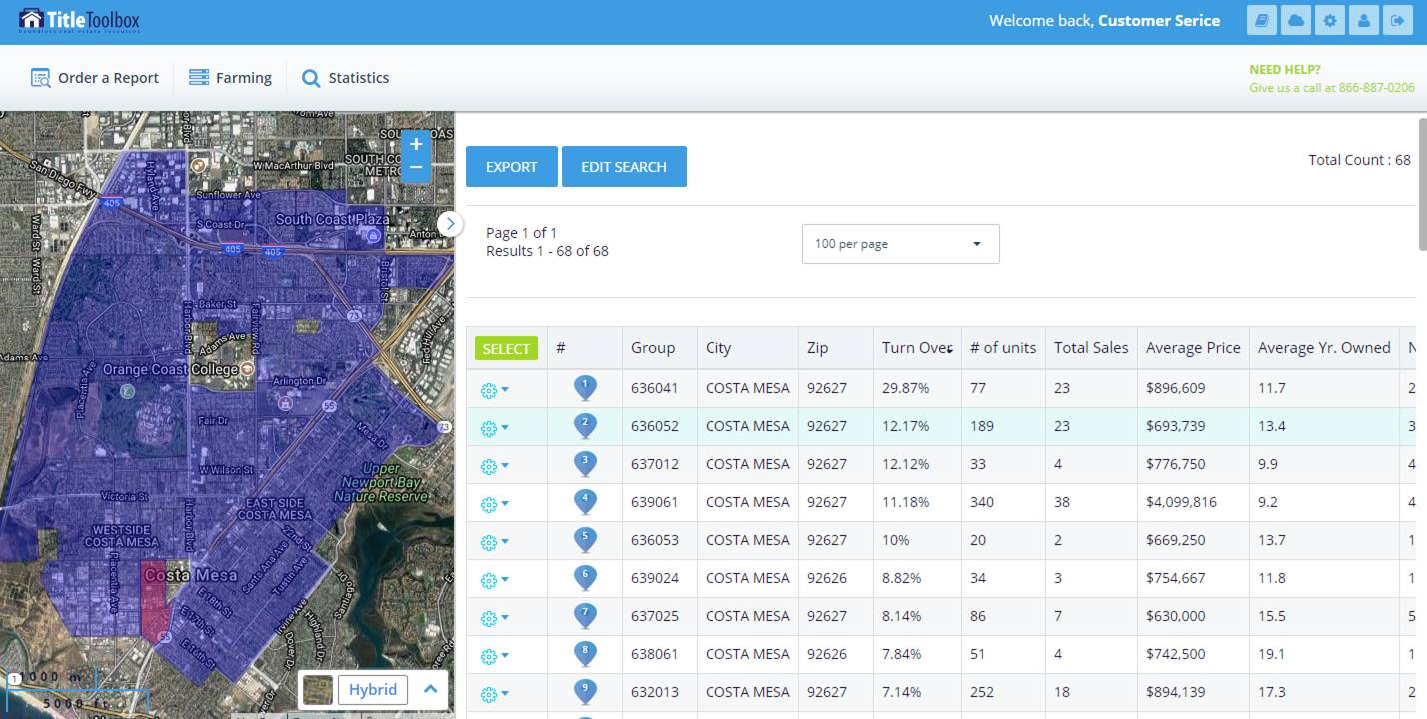
STATISTICS Know where to farm
Using Title Toolbox’s Statistics module you can evaluate area turnover rates and know precisely where to farm.

Slide 5
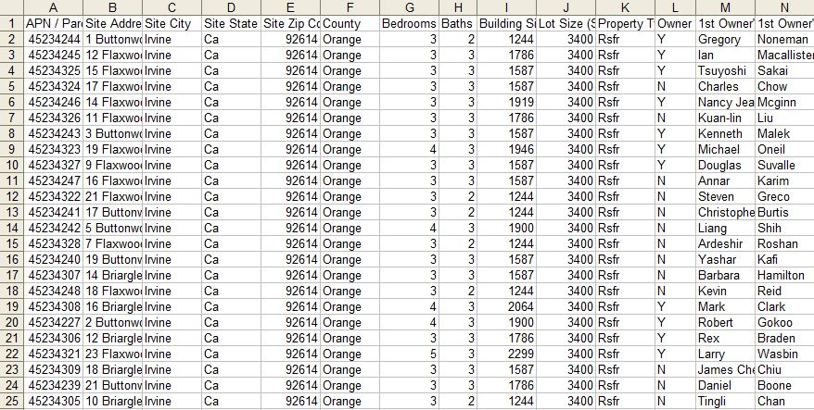
Traditionally farms and data have been delivered to you in spreadsheets.
Data Delivery the traditional method is outdated
What is NOT in those spreadsheets..?
Sales comparables
Mapping of properties
Property profiles and additional reports
Automatically refreshed data
Interactive tools
This requires you to have to individually look up each property by manually typing
addresses into various websites – which is frustrating and time-consuming.
Notes:
With Title Toolbox we’re getting away from the spreadsheet model and we’ve made it interactive and live.

Slide 6
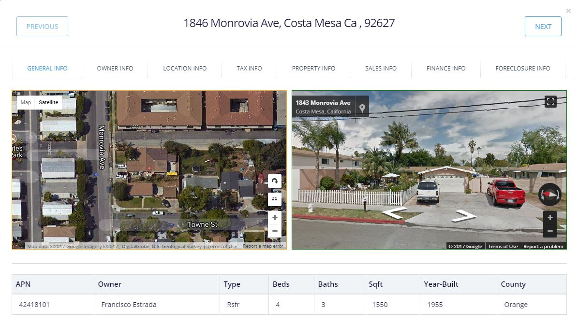
Title Toolbox provides you with the additional data and tools you simply cannot get out of a spreadsheet.
Data Delivery Title Toolbox delivers LIVE data and interactive tools
Sales comparables
Mapping of properties
Property profiles and additional reports
Automatically refreshed data
Interactive tools
Having this access to additional data and tools from Title Toolbox allows for more productivity, better efficiency and reduced cost of doing business.
Notes:
With Title Toolbox we’re getting away from the spreadsheet model and we’ve made it interactive and live.

Slide 7
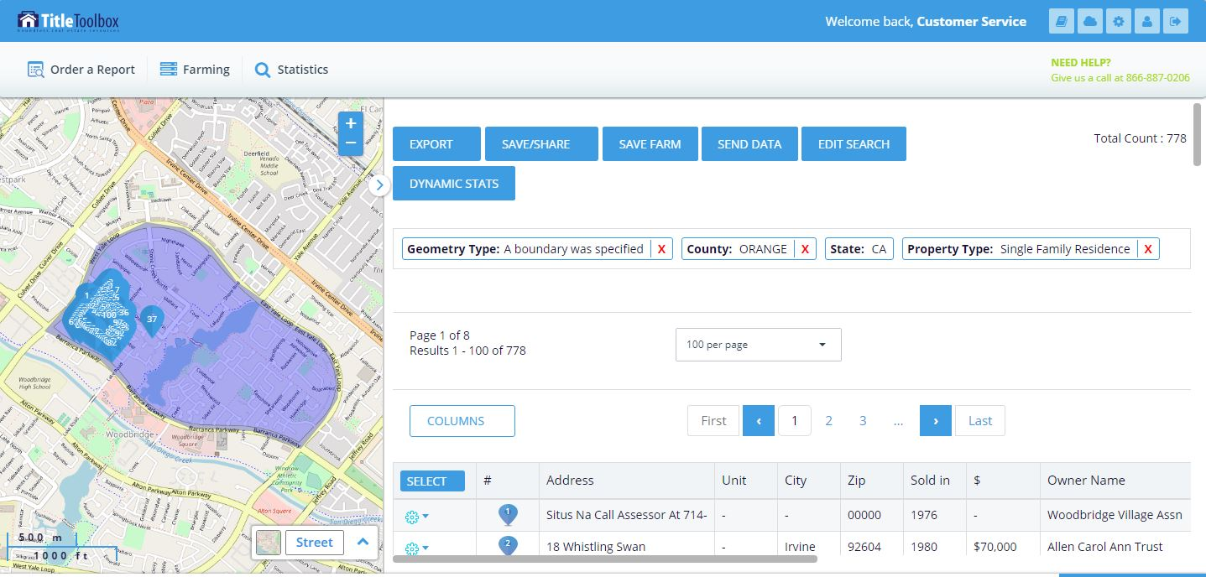
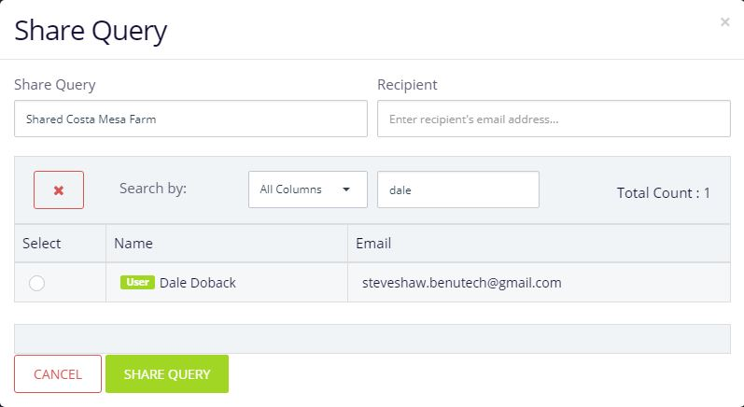
Interactive Tools Shared Searches
✅ Title Rep can share searches with Agent
within Title Toolbox
✅ Agent receives an email with a “hot link”
which takes them directly into the search
within their account, without having
to log-in.
✅ Agent can save the search within their
account, or save the results as a Farm
Agent has access to the same tools and features as Title Rep
Notes:
With Title Toolbox we’re getting away from the spreadsheet model and we’ve made it interactive and live.

Slide 8
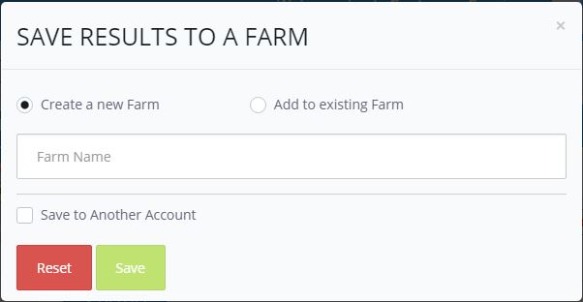
Interactive Tools Saved Farms
✅ Title Rep can save farms directly into
Agent account
✅ Farms can be filtered down to specific
lists of homeowners, such as:
- Absentee Owners
- Empty Nesters
- Next Sellers
✅ See Dynamic Stats on Saved Farms:
- Turnover Rate & Average Price
- Non-Owner Occupied ratio
Notes:
With Title Toolbox we’re getting away from the spreadsheet model and we’ve made it interactive and live.

Slide 9
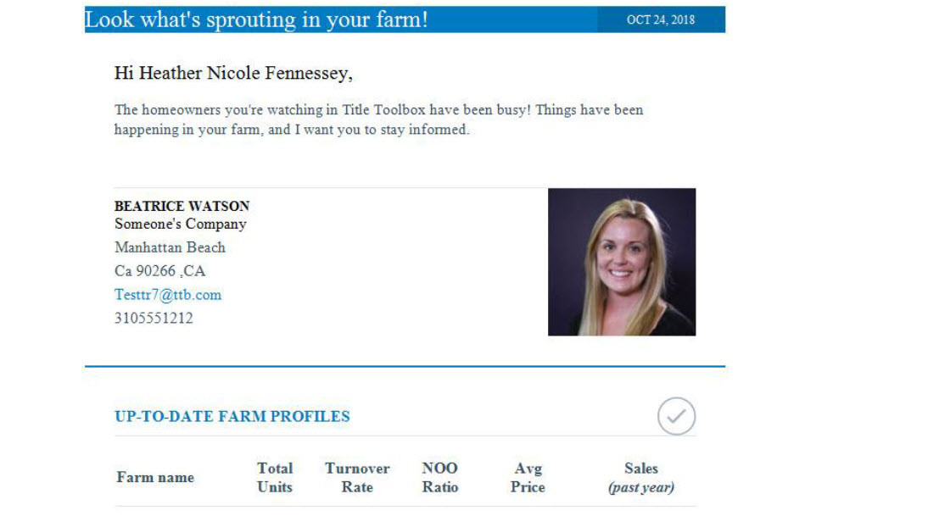
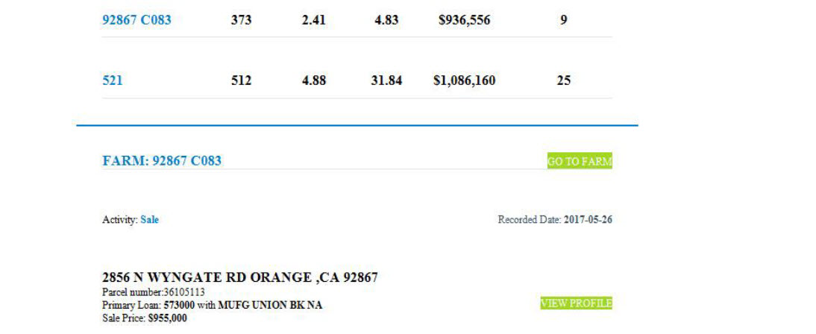
Title Toolbox provides Agents with email updates on their Saved Farms whenever a title change occurs.
Email Notifications Updated Dynamic Stats by Email
✅ Up-to-date Dynamic Stats, including updated:
✅ Turnover rate
✅ Non-owner occupied ratio
✅ Average price
✅ List of properties that recently changed title
✅ Quick link to view Property Profiles
Notes:
With Title Toolbox we’re getting away from the spreadsheet model and we’ve made it interactive and live.

Slide 10
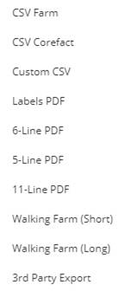
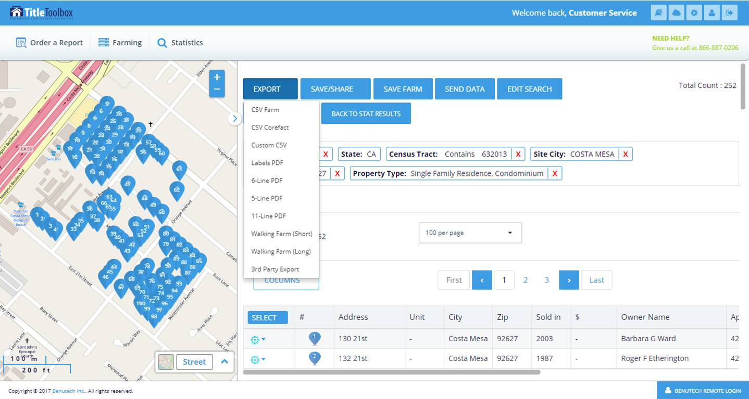
Exporting Ten useful exporting options
Notes:
With Title Toolbox we’re getting away from the spreadsheet model and we’ve made it interactive and live.

Slide 11
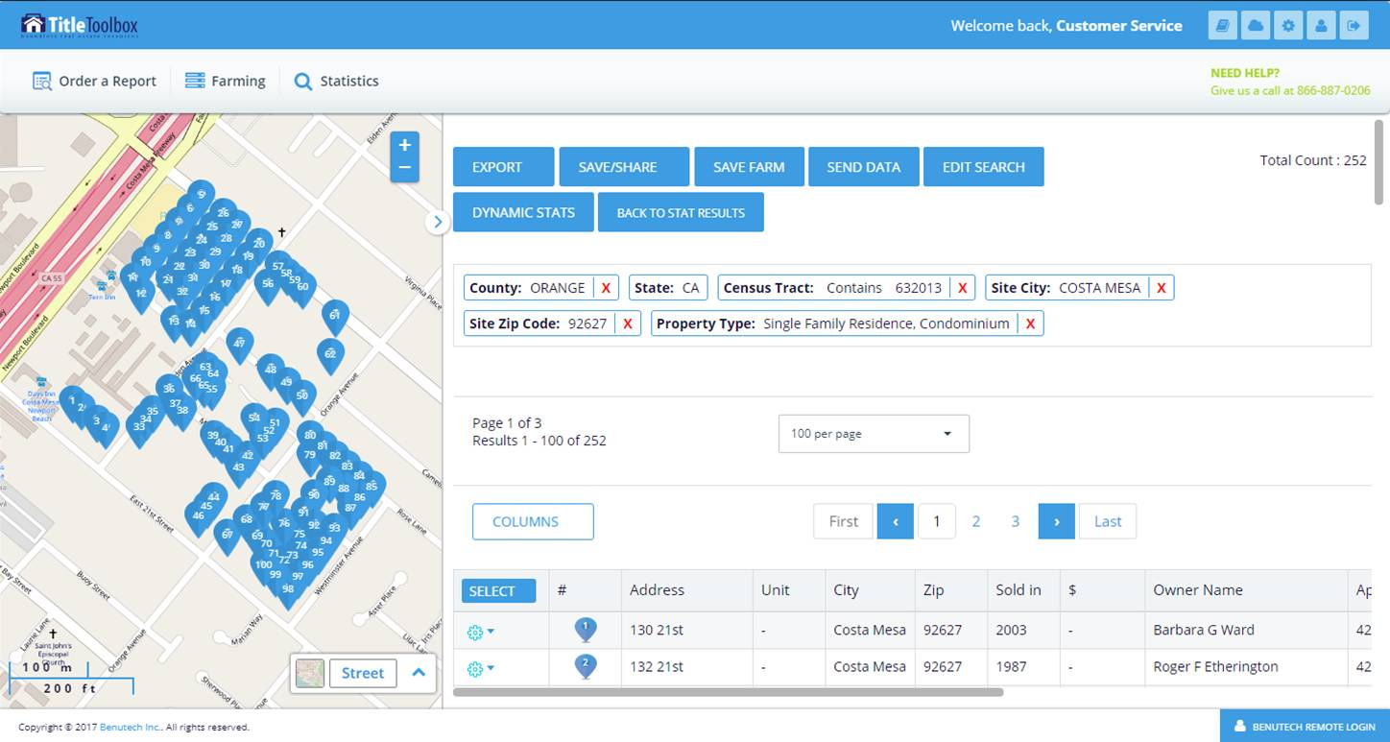
Cloud Admin API The Corefact-Title Toolbox Connection
DOWNLOAD, UPDATE and SYNC with 3rd Party API’s
Notes:
With Title Toolbox we’re getting away from the spreadsheet model and we’ve made it interactive and live.

Slide 12
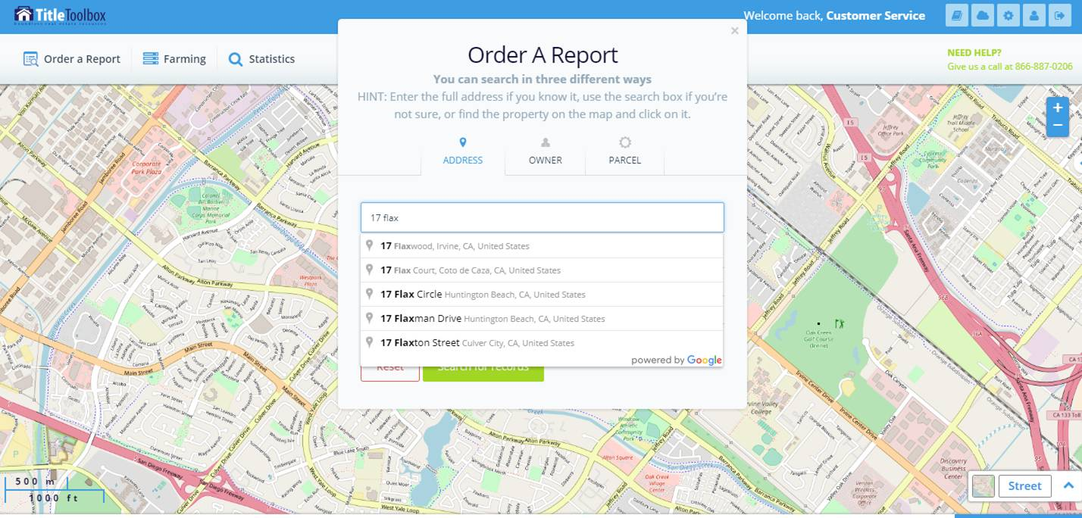
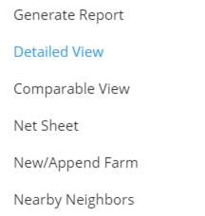
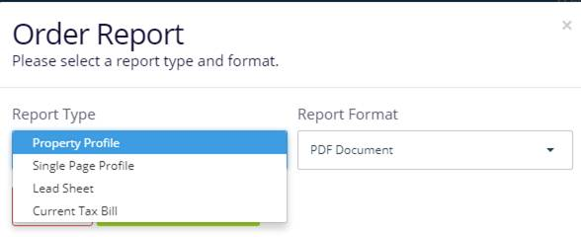
Property Search Comprehensive Reports & Useful Tools
✅ Property profiles & reports
✅ Current Tax Bills (where available)
✅ Comparables
✅ Net Sheet Tool
✅ Nearby Neighbors
Notes:
With Title Toolbox we’re getting away from the spreadsheet model and we’ve made it interactive and live.

Slide 13
Title Toolbox delivers the most comprehensive property data in the U.S. to Real Estate Agents along with needed research analytics all from one source.
And Title Toolbox will keep coming back with patent-pending technology, routine property updates, and convenience found nowhere else.
Your Title Toolbox account is being provided to you for FREE by your Title Rep.
Have you looked inside of your Title Toolbox yet?

